Slide 1
CSE 185 Introduction to Computer Vision
Introduction

Slide 2
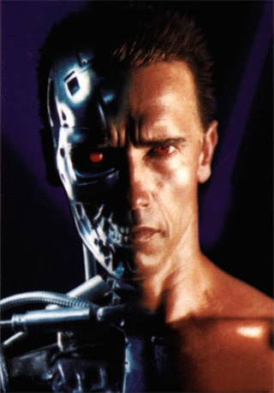
What is computer vision?
Terminator 2
Notes:
Clips: terminator 2, enemy of the state (from UCSD “Fact or Fiction” DVD)

Slide 3
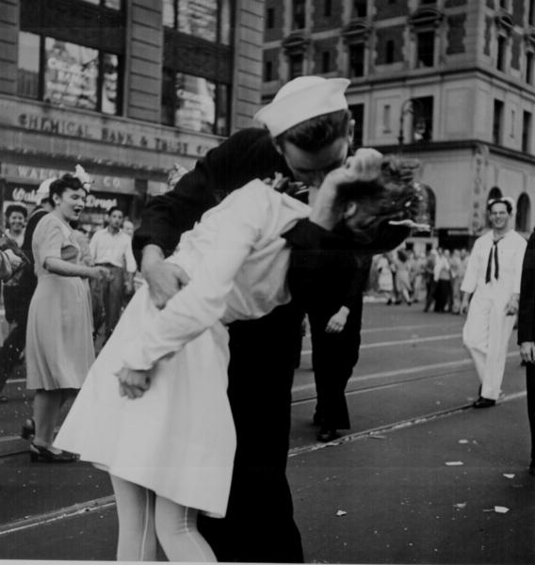
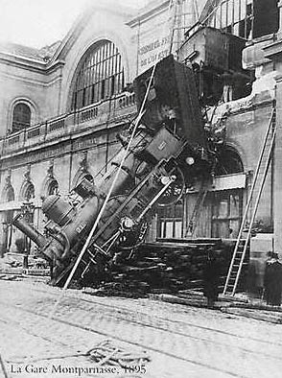
Every picture tells a story
Goal of computer vision is to write computer programs that can interpret images

Slide 4
Can computers match (or beat) human vision?
Yes and no (but mostly no!)
humans are much better at “hard” things
computers can be better at “easy” things
Notes:
If you can write a formula for it, computers can excel
Computer vision can’t solve the whole problem (yet), so breaks it down into pieces.
Many of the pieces have important applications.

Slide 5

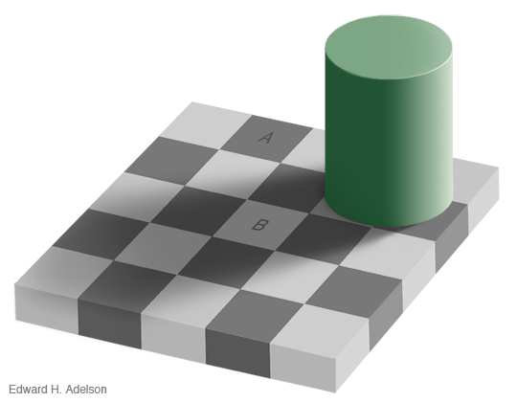
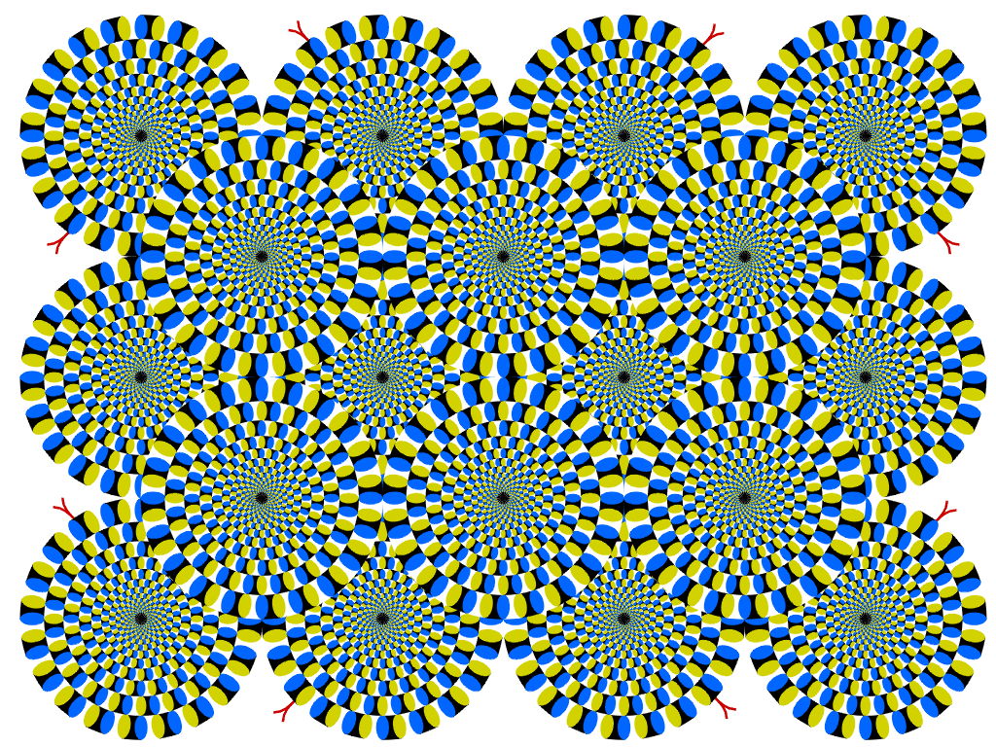
Optical illusions
The squares marked A and B are the same shade of gray
Copyright A.Kitaoka 2003

Slide 6
Rotating diamond wheels motion illusion. The wheels with blue and green diamonds seem to move clockwise when moving the eyes from one to another. Called peripheral drift or Fraser Wilcox illusion.

Slide 7
Why is computer vision difficult?
Inverse problem
Ill-posed
High-dimensional data
Noise
Variation

Slide 8
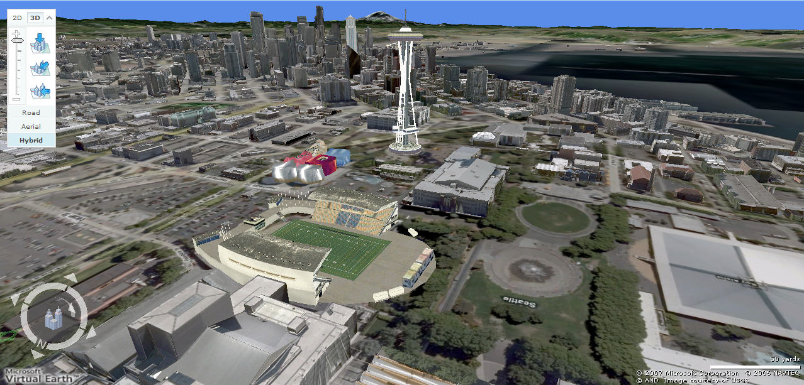
Earth viewers (3D modeling)
Image from Microsoft’s Virtual Earth/Bing Map (see also: Google Earth)

Slide 9
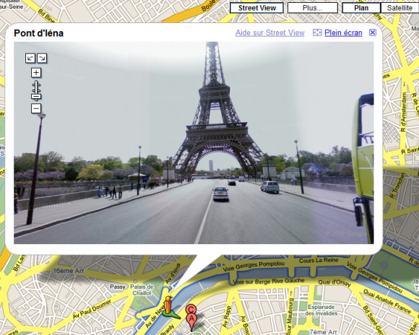
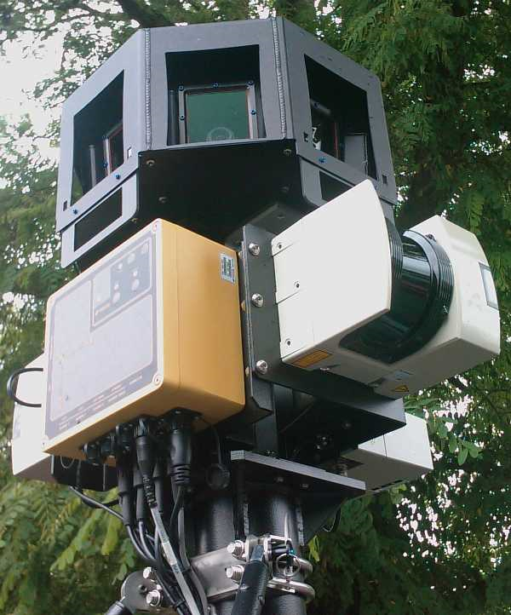
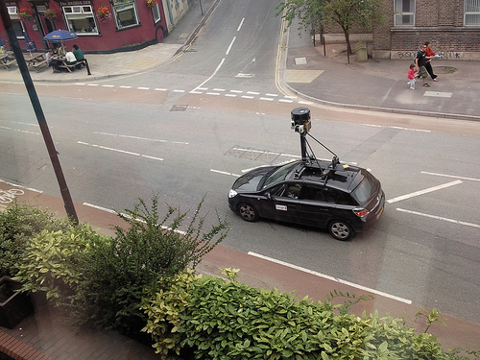
Google street view

Slide 10
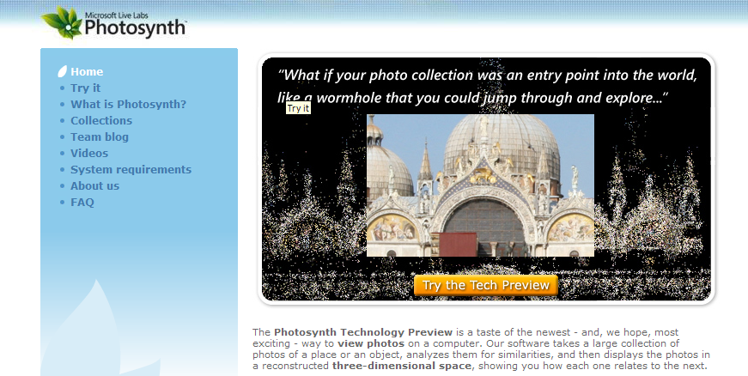
Photosynth
https://www.youtube.com/watch?v=DiM79dcFtLc&t=46s

Slide 11
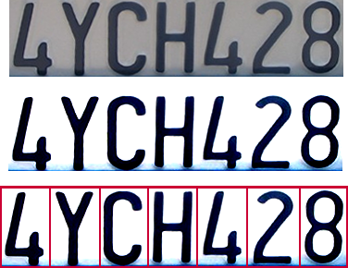

Optical character recognition
Technology to convert scanned docs to text
If you have a scanner, it probably comes with OCR software
Digit recognition, AT&T labs
http://yann.lecun.com/exdb/lenet/index.html
License plate readers
http://en.wikipedia.org/wiki/Automatic_number_plate_recognition

Slide 12
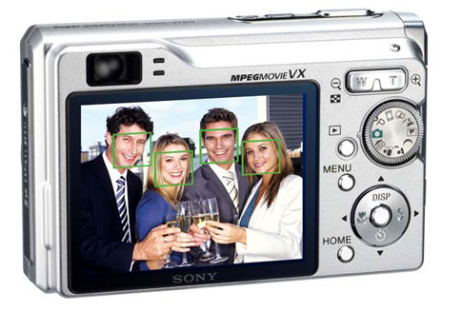
Face detection
Digital cameras and mobile phones detect faces
Notes:
Why would this be useful? Main reason is focus. Also enables “smart” cropping.

Slide 13
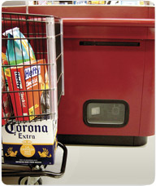
Object recognition (in supermarkets)
“A smart camera is flush-mounted in the checkout lane, continuously watching for items. When an item is detected and recognized, the cashier verifies the quantity of items that were found under the basket, and continues to close the transaction. The item can remain under the basket, and with LaneHawk,you are assured to get paid for it…“

Slide 14

Face recognition
Who is she?

Slide 15
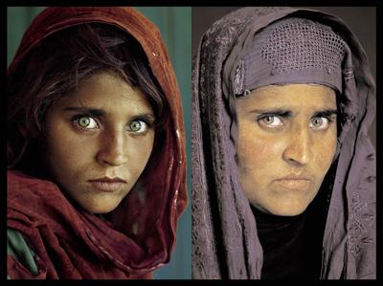
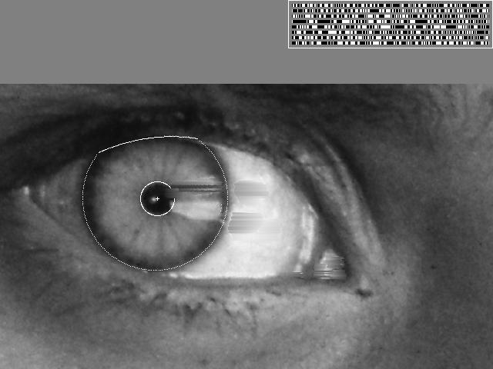
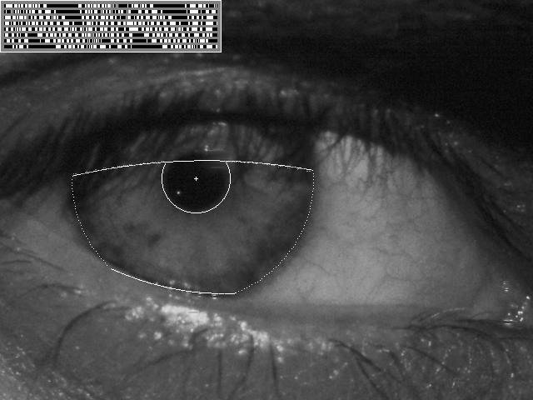
Vision-based biometrics
“How the Afghan Girl was Identified by Her Iris Patterns” Read the story

Slide 16
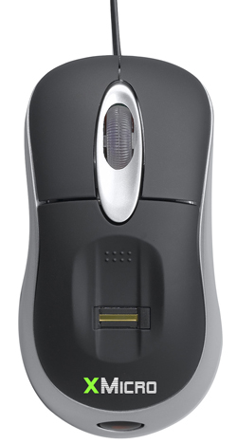
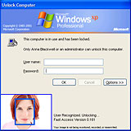
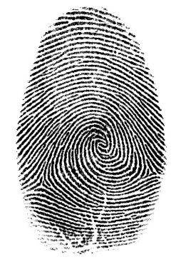

Login without a password…
Fingerprint scanners on many new laptops, other devices (e.g., iphone)
Face recognition systems now beginning to appear more widely http://www.sensiblevision.com/

Slide 17
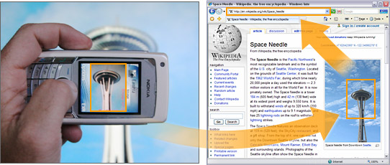

Mobile vision
This is becoming real:
Microsoft Research
NTT Docomo (2005), Google Lens 1 , Google Lens2

Slide 18
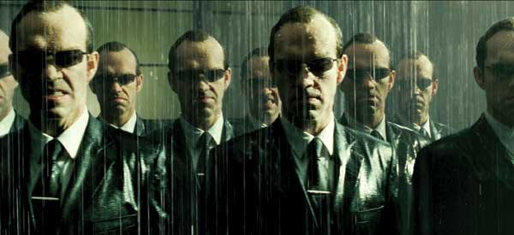
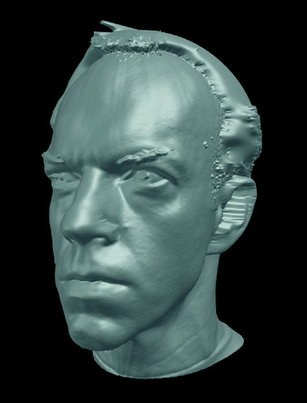
Special effects: shape capturing
Bullet time:
http://www.youtube.com/watch?v=uPNBdDNZbYk
The Matrix movies, ESC Entertainment, XYZRGB, NRC

Slide 19
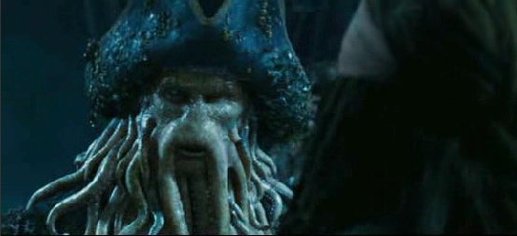
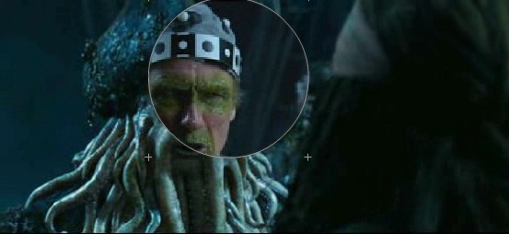
Special effects: motion capture
Pirates of the Caribbean, Industrial Light and Magic
Interactive demo

Slide 20
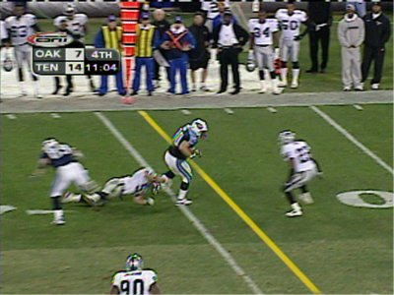
Sports
Sportvision first down line
Nice explanation on www.howstuffworks.com
http://www.youtube.com/watch?v=UyPU2l9rdvo

Slide 21
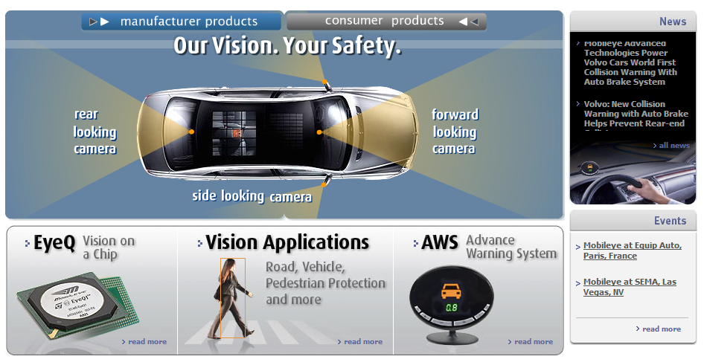
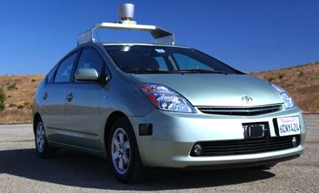
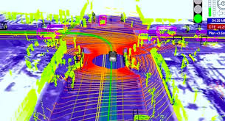
Autonomous driving
Mobileye
Vision systems currently in high-end BMW, GM, Volvo models
By 2010: 70% of car manufacturers.
Video demo
Google/Waymo

Slide 22
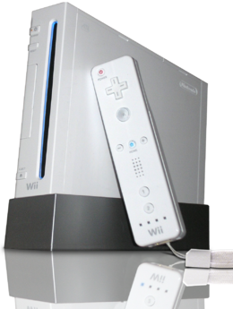
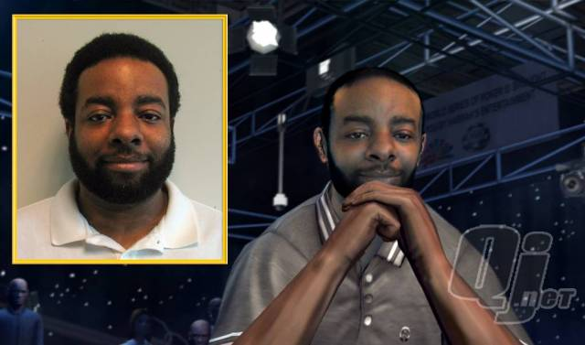
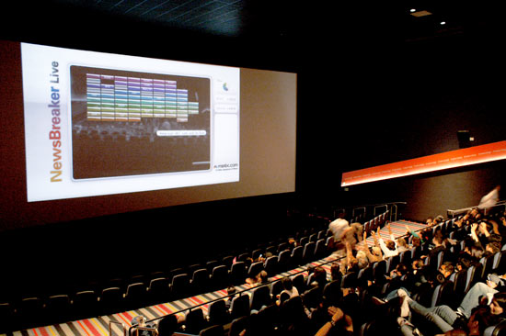
Vision-based interaction
Digimask: put your face on a 3D avatar.
https://www.youtube.com/watch?v=xwawTJPUWkQ
Nintendo Wii has camera-based IR tracking built in. See Lee’s work at CMU on clever tricks on using it to create a multi-touch display!
“Game turns moviegoers into Human Joysticks”, CNET
Camera tracking a crowd, based on this work.

Slide 23
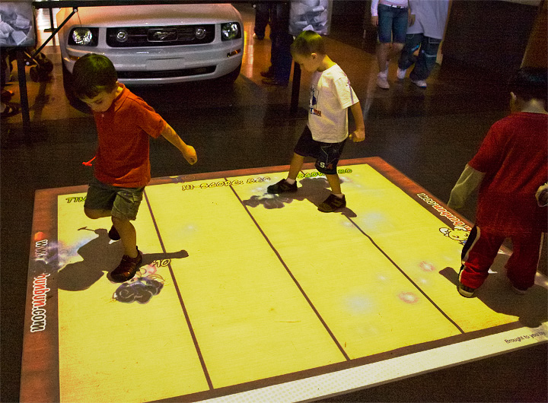
Vision-based HCI
Reatrix: http://www.youtube.com/watch?v=QzsQKULMbiU

Slide 24
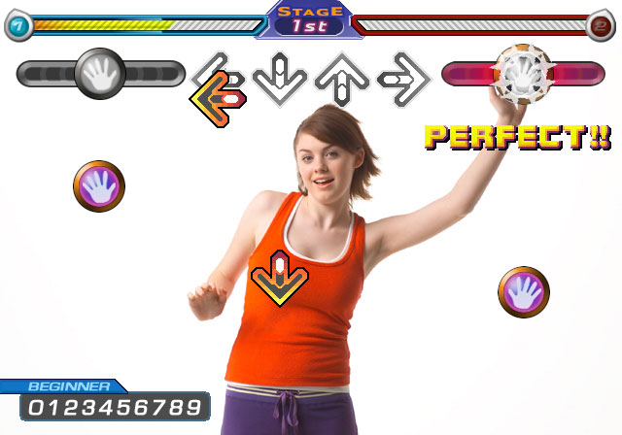
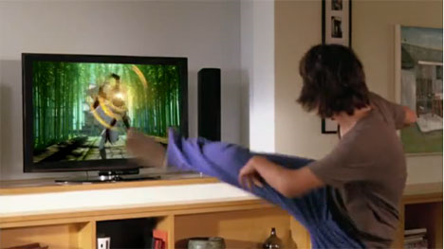
Gaming
Sony Eyetoy
Microsoft Kinect
http://www.youtube.com/watch?v=wKXncqEYk9g
https://www.youtube.com/watch?v=pzfpXAbQ61U

Slide 25
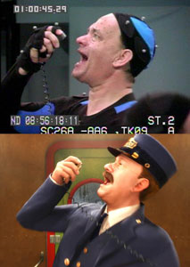
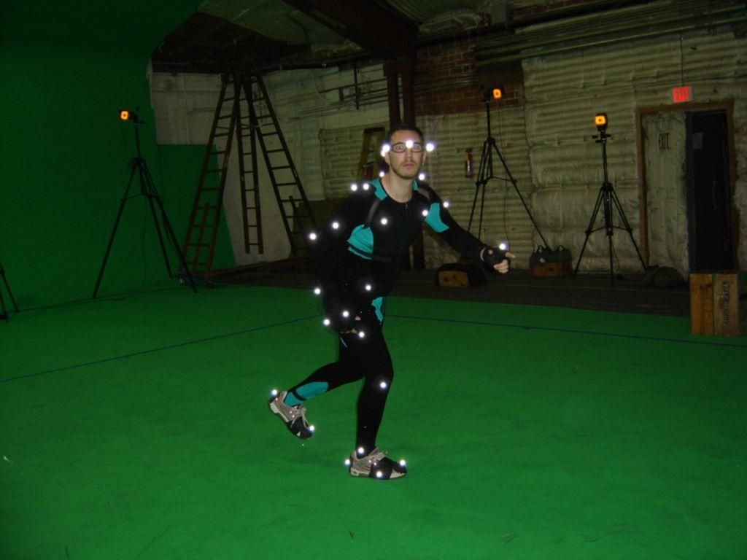
Motion capture
Marker-based motion capture
http://www.youtube.com/watch?v=V0yT8mwg9nc

Slide 26
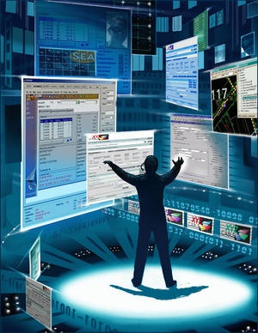
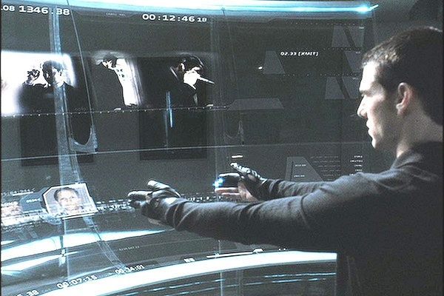
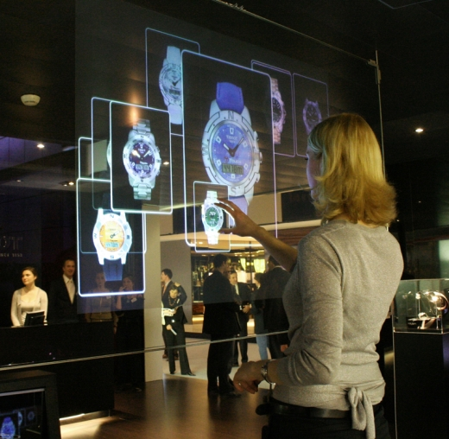
Looking at people
Hand gesture
Head pose
Expression
Identity
http://www.youtube.com/watch?v=MsGCczPrJFE

Slide 27
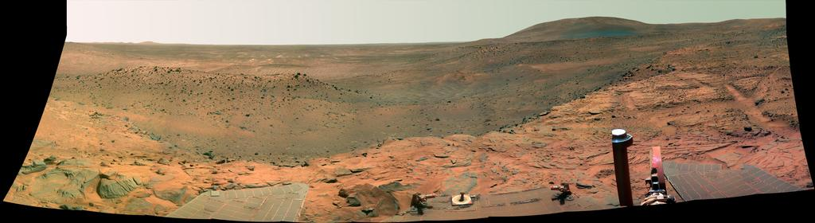
Vision in space
NASA'S Mars Exploration Rover Spirit captured this westward view from atop a low plateau where Spirit spent the closing months of 2007.
Vision systems (JPL) used for several tasks
Panorama stitching
3D terrain modeling
Obstacle detection, position tracking
For more, read “Computer Vision on Mars” by Matthies et al.

Slide 28
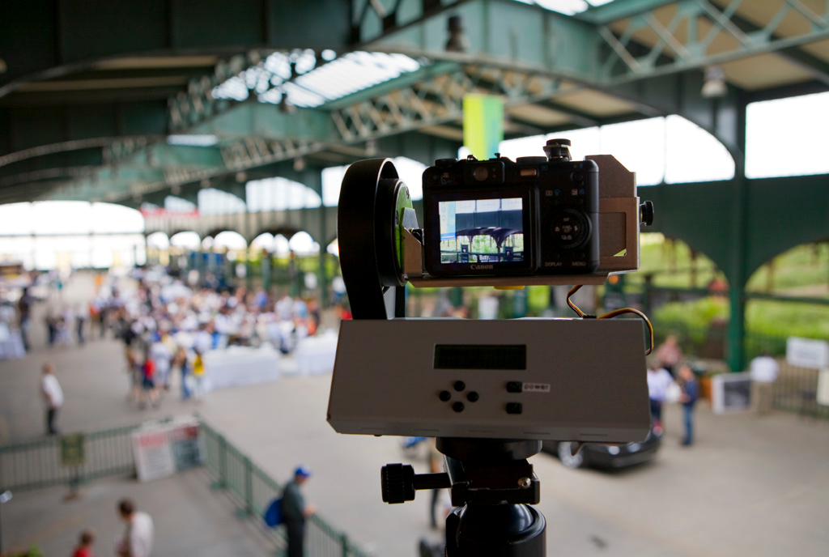
Gigapan
Gigapan, gallery
HP Touch Smart with Gigapn demo at Chicago O’Hare airport

Slide 29
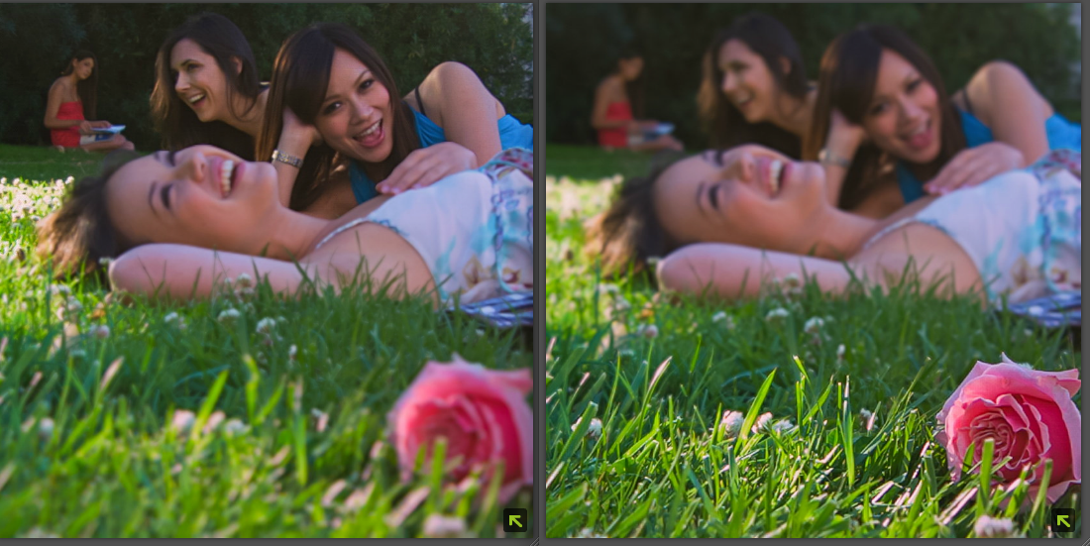
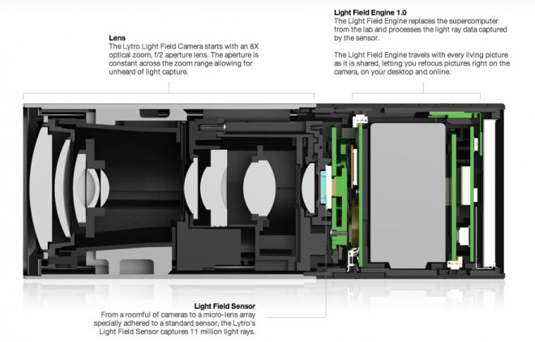
Light field camera
Lytro: light field camera
https://www.youtube.com/watch?v=Nis4yGnUHfE

Slide 30

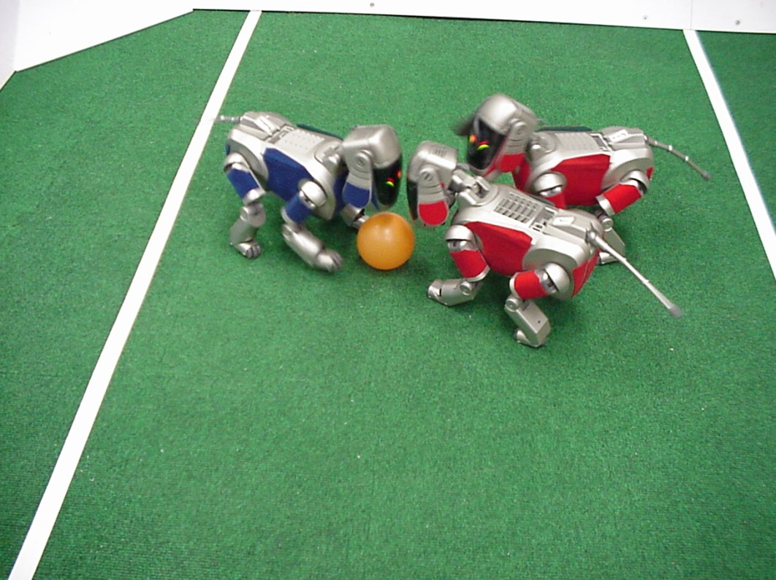
Robotics
NASA’s Mars Spirit Rover
http://en.wikipedia.org/wiki/Spirit_rover
http://www.robocup.org/

Slide 31
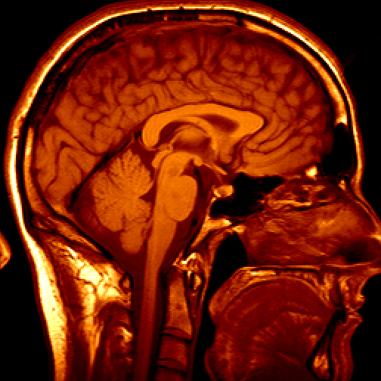
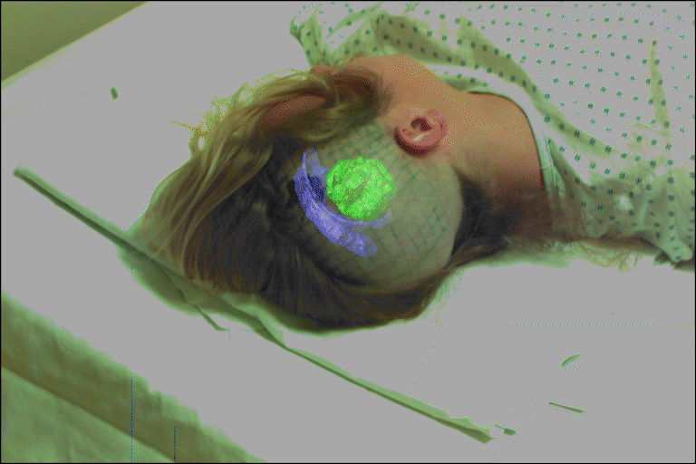
Medical imaging
3D imaging
MRI, CT
Image guided surgery
Grimson et al., MIT

Slide 32
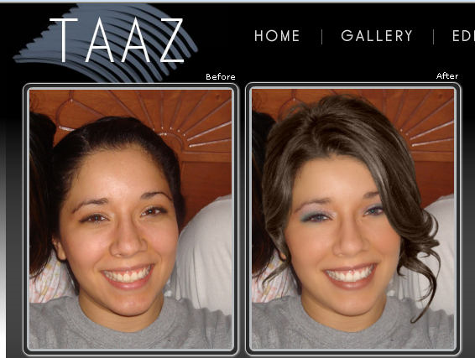
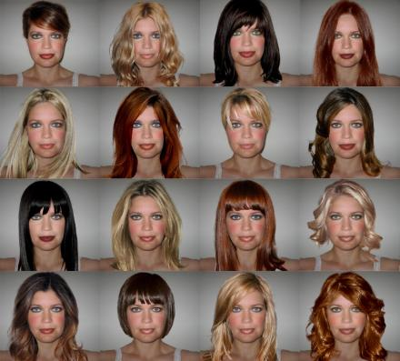
Digital comestics

Slide 33
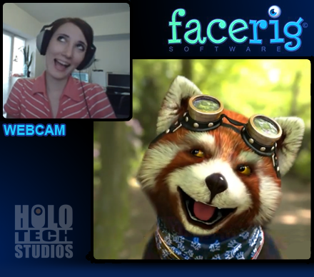
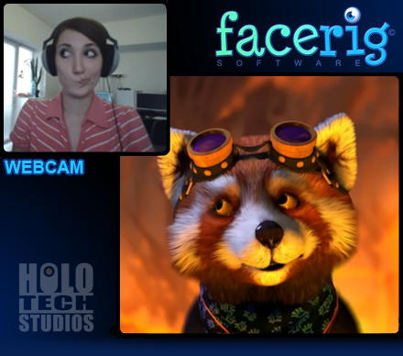
Avatar
Facerig: https://facerig.com/

Slide 34






Inpainting
Bertalmio et al. SIGGRAPH 00

Slide 35

Visual priming
Torralba and Sinha ICCV 01

Slide 36

Object detection
Heitz and Koller ECCV 08

Slide 37
Sci-Fi?
Image enhancement http://www.youtube.com/watch?v=Vxq9yj2pVWk
Person of interest https://www.youtube.com/watch?v=7U9FuRnyiqk

Slide 38

Image search
Wu et al. CVPR 09

Slide 39

Scene understanding
Leibe et al. CVPR 07

Slide 40
Scene parsing
Example 1: https://www.youtube.com/watch?v=ZVHEHeuxI10
Example 2: https://www.youtube.com/watch?v=zU7VGfVNvjw

Slide 41

Image/video segmentation
Figure/ground separation
Green/blue screen
Change/fill contents

Slide 42

Face parsing

Slide 43

Seam carving
Image resizing/retargeting
http://www.faculty.idc.ac.il/arik/SCWeb/imret/
http://www.youtube.com/watch?v=6NcIJXTlugc#t=11

Slide 44
Digital photo albums
Picasa, Flickr, Photobucket, etc.
Categorization
Tagging
Search

Slide 45

Computational photography
Ahuja et al.

Slide 46



Dehazing
Jia et al. CVPR 08
He et al. CVPR 09

Slide 47

Debluring

Slide 48

Computational photography
Johnson and Adelson CVPR 09

Slide 49


Super resolution

Slide 50

Parallax
How to animate a photo: 2.5D effect
http://www.youtube.com/watch?v=ZVrYyX3bHI8
Foreground/background separation
Camera pose
This animation is an example of parallax.
As the viewpoint moves side to side, the objects in the distance appear to move slower than the objects close to the camera.

Slide 51
Computational photography
Image acquisition
Hardware/software
Optics
Shutter speed
Novel sensors
Multiple camera
Multiple shots
Multi flash
Applications: high dynamic range imaging, super resolution, photomontage, panorama moasicing, debluring, light field, camera projector system…

Slide 52
Image and video search
Google
Facebook
Youtube
Microsoft
Amazon
Apple
…

Slide 53
Current state of the art
You just saw examples of current systems.
Many of these are less than 5 years old
This is a very active research area, and rapidly changing
Many new applications in the next 5 years
To learn more about vision applications and companies
David Lowe maintains an excellent overview of vision companies
http://www.cs.ubc.ca/spider/lowe/vision.html
Confluence of vision, graphics, learning, sensing and signal processing

Slide 54

Image synthesis
Generative Adversarial Network (GAN)

Slide 55

Image synthesis
Generative Adversarial Network (GAN)

Slide 56



Image synthesis from text
DALLE-2
Imagen
“A modern, sleek Cadillac drives along the Gardiner expressway with downtown Toronto in the background, with a lens flare, 50mm photography.”
“A man walking through the bustling streets of Kowloon at night, lit by many bright neon shop signs, 50mm lens.”
“A photo of an astronaut riding a horse.”

Slide 57
Software and hardware
Algorithms: processing images and videos
Camera: acquiring images/videos
Embedded system

Slide 58
Topics
Image formation: camera and optics
Early vision: light, color, image filtering, edge, interest points, corners, features, stereo
Mid-level vision: clustering, grouping, segmentation
High-level vision: correspondence, matching, object detection, object recognition, visual tracking
Deep learning

Slide 59
History
“In the 1960s, almost no one realized that machine vision was difficult.” – David Marr, 1982
Marvin Minsky asked Gerald Jay Sussman to “spend the summer linking a camera to a computer and getting the computer to describe what it saw” – Crevier, 1993
50+ years later, we are still working on this

Slide 60

1970s

Slide 61

1980s

Slide 62

1990s
Face detection
Particle filter
Pfinder
Normalized cut

Slide 63




2000s
SIFT
Mosaicing, panorama
Object recognition
Photo tourism, photosynth
Human detection
Adaboost-based face detector

Slide 64
2010s
Real-world applications
Google: image search, glass, X, autonomous driving, product search
Adobe, Microsoft, Facebook, Apple, Toyota, Honda, Amazon
Applications for autonomous driving
Mobile phones
Deep learning

Slide 65
2020s
Deep learning dominates the landscape
Vision and language
Foundation models
Large-scale applications

Slide 66

Related topics

Slide 67
Textbooks and references
Textbook
Computer Vision: Algorithms and Applications, Richard Szeliski (available online)
Reference for background study:
Computer Vision: Models, Learning, and Inference, Simon Prince
Introductory Techniques for 3-D Computer Vision, Emanuele Trucco and Alessandro Verri
Programming Computer vision with Python, Jan Erik Solem
Learning OpenCV: Computer Vision with OpenCV Library, Gary Bradski and Adrian Kaehler
Reading assignments will be from the text and additional material that will be handed out or made available on the web page
All lecture slides will be available on the course website and Catcourses
http://faculty.ucmerced.edu/mhyang/course/cse185/index.htm

Slide 68
Grading
50% Lab assignments (10 or 11 programs)
20% Midterm exam
30% Final exam

Slide 69
Prerequisites
Prerequisites—these are essential!
Linear algebra
Vector calculus
A good working knowledge of MATLAB, C, and C++ programming
Course does not assume prior imaging experience
computer vision, image processing, graphics, etc.

Slide 70
Course polices
Do not use computers or smart phones
No make-up exam
Ask questions anytime

Slide 71
Acknowledgements
Slides
Richard Szelski and Steve Seitz
David Forsyth and Jean Ponce
Many others

